Slide 1
Module 2: Analyzing Performance

Slide 3
Objectives
Learn how to analyze performance measurements
Learn how to find bottlenecks

Slide 4
Analyzing performance

Slide 5
Aspects impacting performance
Memory management
Data structures
Concurrency
Network communication
Scalability

Slide 6
Aspects impacting performance, cont’d
Large message payloads
Large volumes of message
Poorly written applications

Slide 7
Core performance principles
Memory is faster than disk (much faster) and is cheap
All storage (memory/disk) works fastest when read from or written to sequentially
Object allocation and garbage collection is slow
Data formats and data structures make a big difference in speed
Asynchronous IO scales better than synchronous IO
Single threaded performance is a prerequisite for multithreaded performance
Shared memory (or disk) concurrency is bad because it usually leads to lots of contention when the system gets busy

Slide 8
Inspecting Mule applications

Slide 9
Why inspect?
Get detailed information on your application’s performance and resource consumption
May help identify bottlenecks that are not exposed by log messages
Real time insight in your application
Usually not very intrusive

Slide 10
Inspection tools
jConsole, VisualVM, Java Mission Control (bundled with JDK)
Heap Analyzer
JAMon
GCViewer
AppDynamics
NewRelic
JProfiler
YourKit

Slide 11
Walkthrough 2-1: Inspecting Mule applications
In this walkthrough, you will learn how to inspect a running Mule application and observe its behavior

Slide 12
Analyzing performance metrics

Slide 13
Gathering performance metrics
The JDK comes bundled with several tools for gathering, inspecting and monitoring performance metrics/statistics
jmap: create heap dump
jmap –heap <pid>
jstack: create thread dump
jstack -l <pid> > <file-path>
In case of performance issues (or bugs), it can be helpful to make a heap dump or thread dump

Slide 14
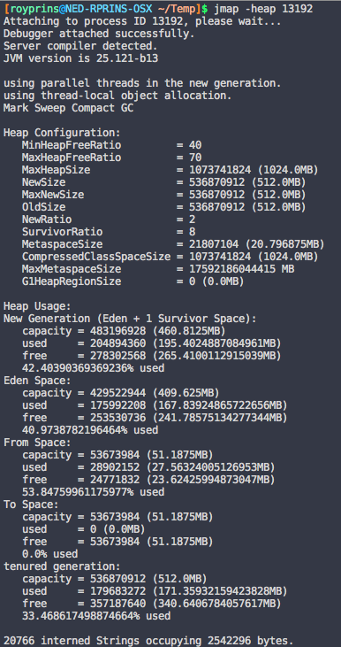
Create a heap dump
Get the proper Java process ID first
ps –ef | grep –i java
Use ‘jmap’ to create a heap dump
jmap –heap 123456
This affects running applications!

Slide 15
Create a heap dump using VisualVM
VisualVM has built-in heap dump functionalities

Slide 16
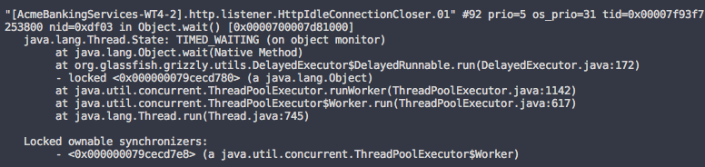
Create a thread dump
Get the proper Java process ID first
ps –ef | grep –i java
Use ‘jstack’ to create a thread dump
Output to a file is recommended
jstack –l 123456 > threads.txt

Slide 17
Why is this useful?
Allows you to create snapshot of a certain point in time
MuleSoft support can ask you for it when reporting bugs
But also
Find performance bottlenecks
Find memory leaks

Slide 18
Analyzing a thread dump
Useful tools:
fastThread (fastthread.io)
TDA (Thread Dump Analyzer)

Slide 19
Thank you

